Slide 1
Data Science and
Retirement Planning
Steve Donahue

Slide 2
About Me
Mathematician
Master of Arts
Twice-published
Programmer + Data Geek
Educator
9 years teaching undergraduate courses
Rowan, Rutgers Universities
Camden and Cumberland CC’s
Millenial
Musician
Athlete
World Traveler

Slide 3

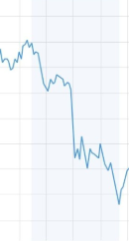


The Lingering Specter of 2008

Slide 4

All Weather Portfolio
30% in Stock Index
40% in Intermediate-Term Bonds
15% in Long-Term Bonds
7.5% in Gold
7.5% in Broad Basket Commodities
Yearly average returns = 9.72%
In its worst year loss = 3.93%

Slide 5
The Process
NYSE
Data
Simulation Analysis
Machine Learning
Results

Slide 6
NYSE Data

Slide 7
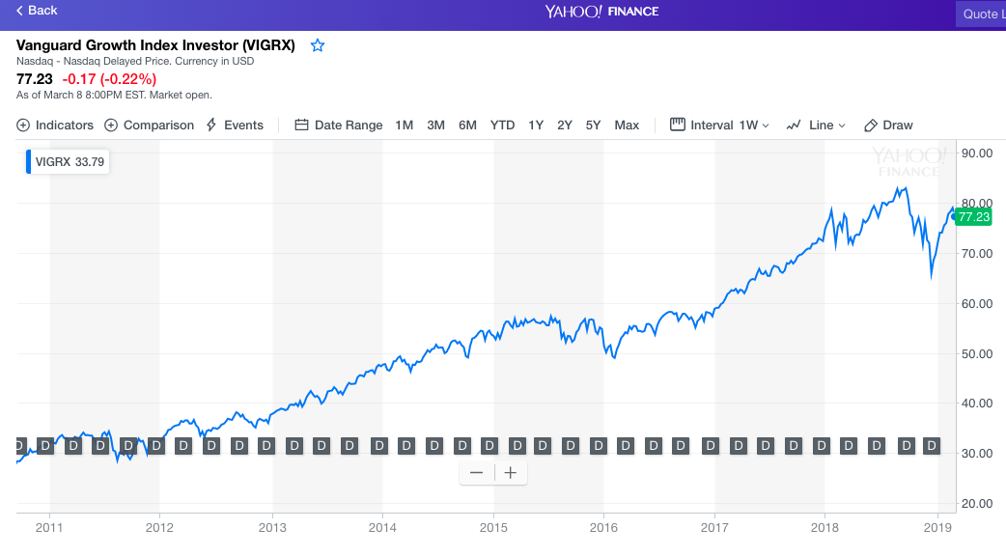
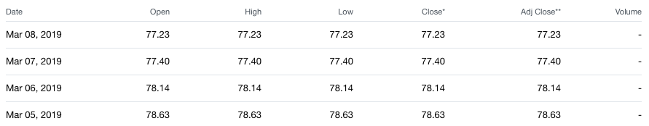
The Funds
Stocks: FUSEX, FXAIX, PREIX, SWPPX, VIGRX, VFINX
Intermediate Term Bonds: BIV, HYG, IEF, IEI, IGIB, ITE, TIP
Long Term Bonds: PRULX, WHOSX, VUSTX
Gold: INIVX, OPGSX, SGGDX, USERX, VGPMX
Broad Basket Commodities: DBC, DJP, GSG, GSP
Yahoo Finance
Contains clean, daily records, which can be requested by specifying a fund by its NYSE ticker code.

Slide 8
Simulation and
Analysis

Slide 9
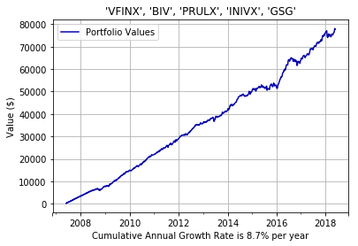
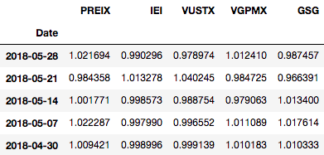
Randomization Performance

Slide 10
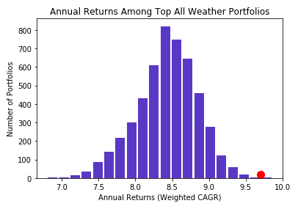
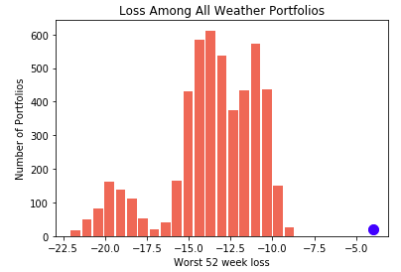
5000 Portfolio Simulation

Slide 11
TOP PERFORMING ALL WEATHER
STOCK INDEX: VIGRX INTERMEDIATE BONDS: IEF
LONG TERM BONDS: WHOSX GOLD: SGGDX
COMMODITIES: ANY
CUMULATIVE ANNUAL GROWTH RATE: 9.99%
WORST LOSS IN A 52 WEEK PERIOD: - 9.33%
PAST PERFORMANCE NOT A GUARANTEE OF FUTURE PERFORMANCE

Slide 12
Machine
Learning

Slide 13
Important Questions
What should this Machine Learning application accomplish?
What assumptions are unique to this application?
How will the tools be evaluated?

Slide 14
How this project addresses those questions:
Train ML tools to predict a loss of 2% or more in the next week.
Following All Weather philosophy = hands off approach
Reducing loss is more important than maximizing gain
Assume
Other areas of the market have predictive power
2% threshold is sufficient to be distinguished from “noise”
Make a binary classification, and evaluate using F1 score, as opposed to a regression estimate and computing RMSE.

Slide 15
ML Tools
The Classifiers:
Support Vector Machine
Logistic Regression
Gradient Boosting
Decision Tree
Random Forest
Data Interpolation:
Naive Resampling
SMOTE
ADASYN

Slide 16
The Results

Slide 17
TOP PERFORMING CLASSIFIERS
Random Forest (SMOTE) F1 Scores: .84/.83
Random Forest, tuned (SMOTE) F1 Scores: .65/.64
Random Forest, tuned (ADASYN) F1 Scores: .63/.66
Here, the scores are formatted according to outcome:
(Predicting a loss of 2% or more) / (Not predicting a loss of 2% or more)
Model accuracy usually fall somewhere between the two values.

Slide 18
Next Steps:
Develop functions to apply ML Classifiers to data
Simulate results, and evaluate best outcomes
Automate best methods to a weekly recommendation

Slide 19
Thank you!
Steve Donahue
sdonahue0132@gmail.com
www.github.com/sdonahue0132

